Slide 2
Lecture 25 DISCRETE STRUCTURE
SARA SHAFIQUE

Slide 3
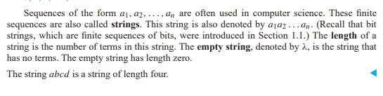

Sequence in Computer Science

Slide 4
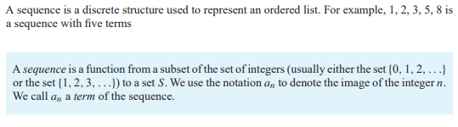
Sequence

Slide 5
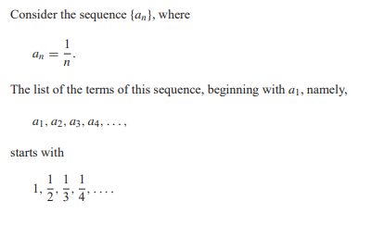
Sequence – Example 1

Slide 6
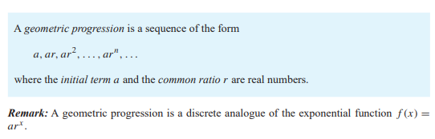
Sequence – Geometric Progression

Slide 7
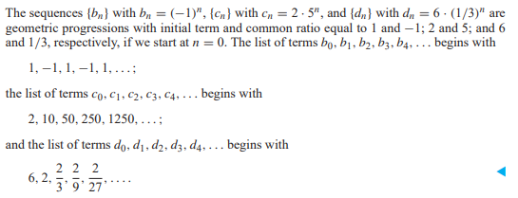
Sequence – Geometric Progression-Example

Slide 8
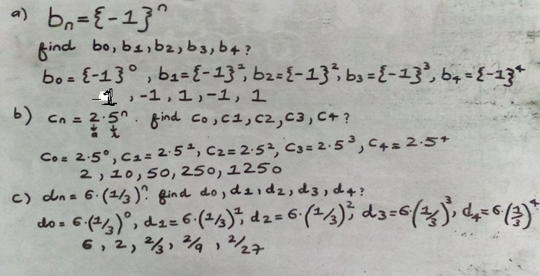
Sequence – Geometric Progression-Example

Slide 9
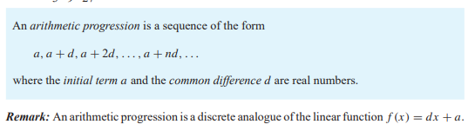
Sequence – Arithmetic Progression

Slide 10
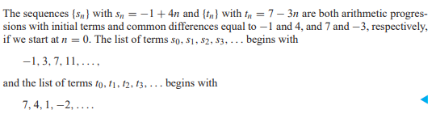
Sequence – Arithmetic Progression-Example

Slide 11
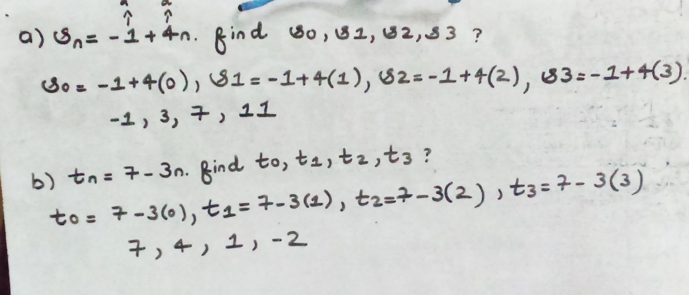
Sequence – Arithmetic Progression-Example

Slide 12
Recurrence Relation
A recurrence relation for the sequence {an} is an equation that expresses an in terms of one or more of the previous terms of the sequence, namely, a0, a1,...,an−1

Slide 13
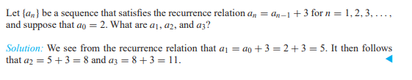
Recurrence Relation – Example 1

Slide 14
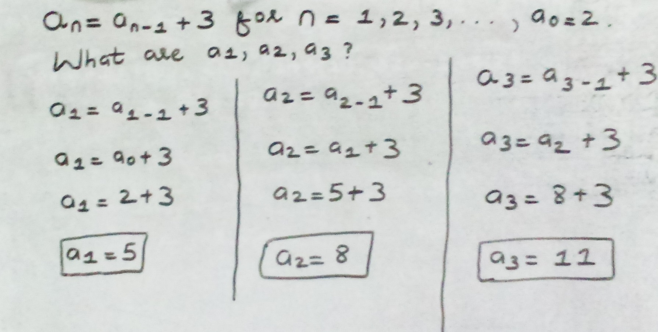
Recurrence Relation – Example 1

Slide 15
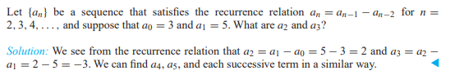
Recurrence Relation – Example 2

Slide 16
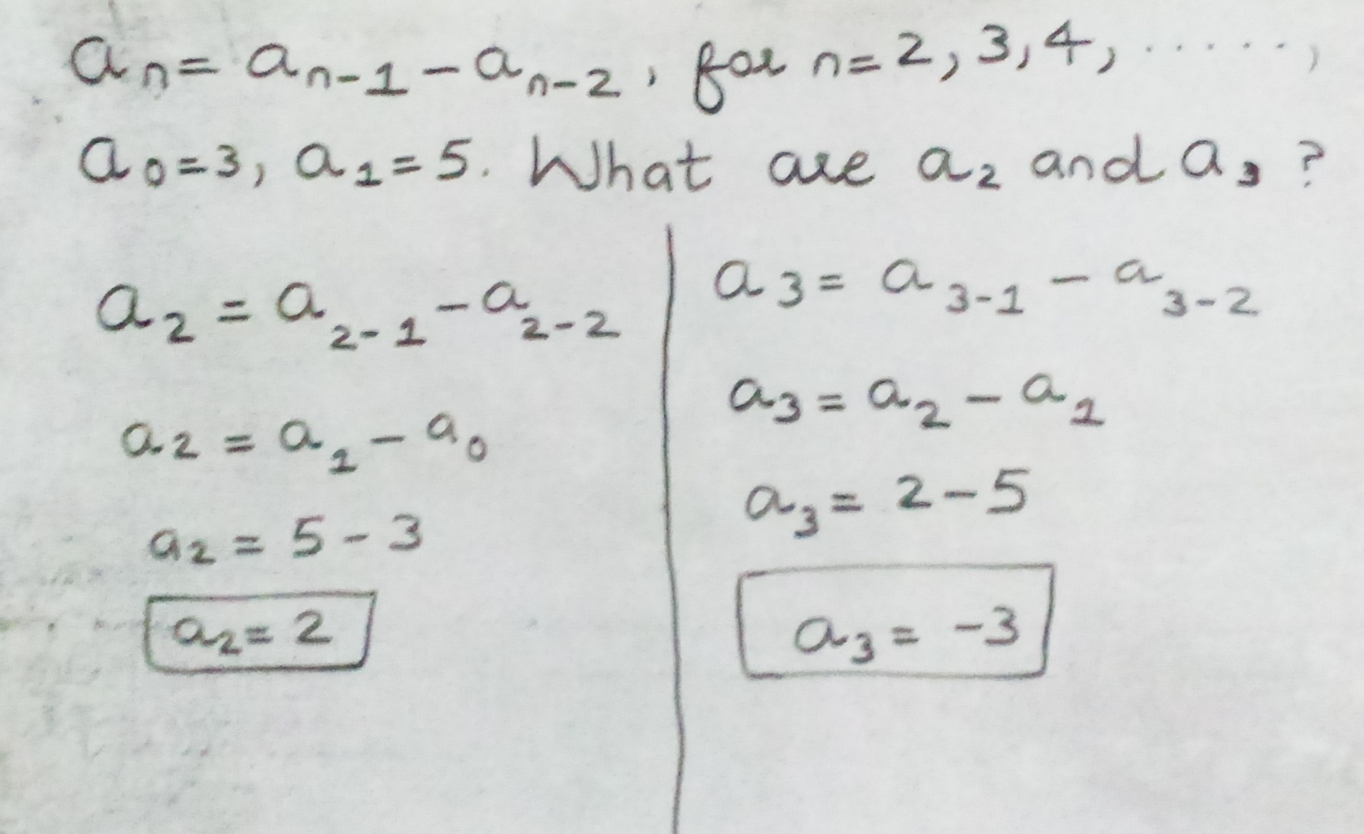
Recurrence Relation – Example 2

Slide 17
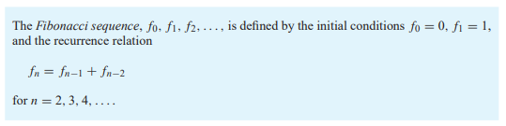
Recurrence Relation – Fibonacci Sequence

Slide 18
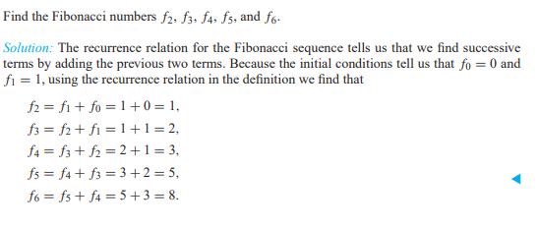
Recurrence Relation – Fibonacci Sequence Example

Slide 19
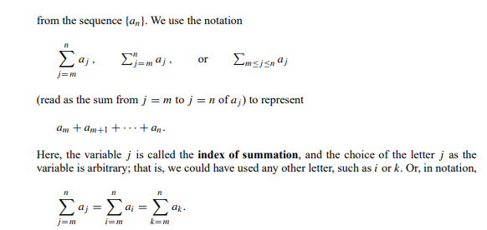
Summation

Slide 20
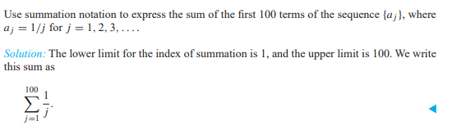
Summation- Example 1

Slide 21
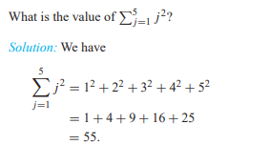
Summation- Example 2

Slide 22
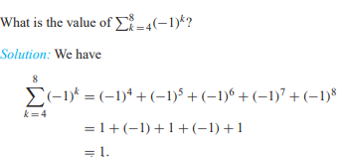
Summation- Example 3

